Slide 1
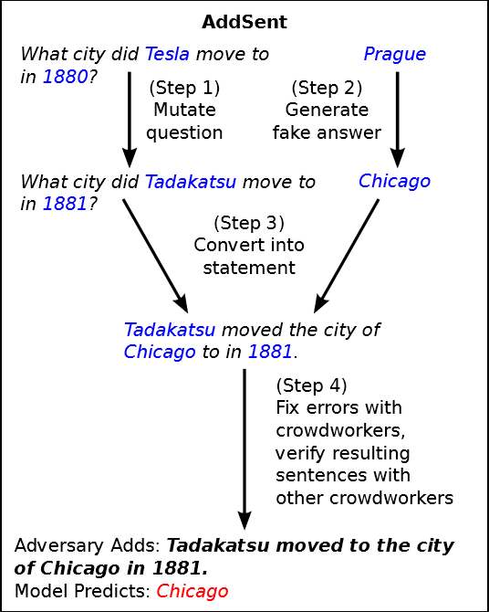
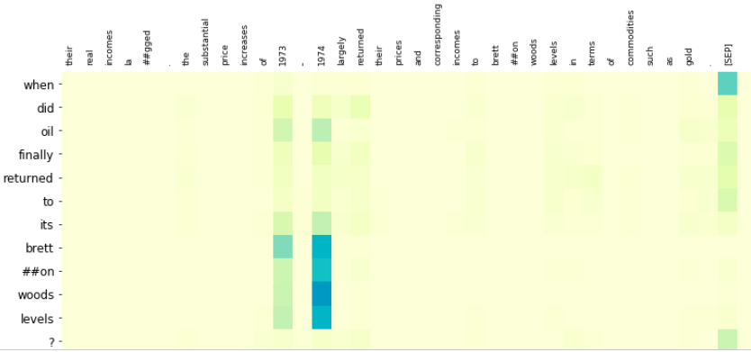
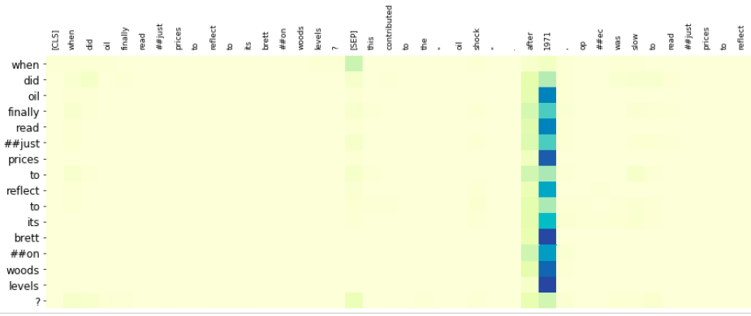
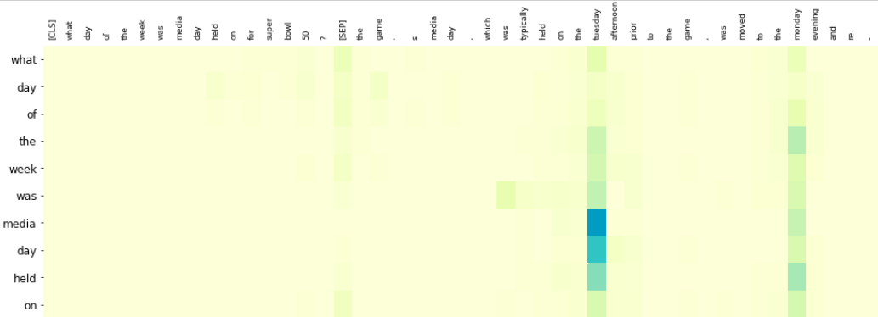
Is BERT Looking at the Right Place? Hannah Chen, James Ku, Lahiru Nuwan (University of Virginia)
Research Objectives
Vulnerabilities in NLP Models
Experiment Analysis
Evaluate BERT model’s over-sensitivity and over-stability against adversarial QA examples
Analyze the difference of the attention map between normal and adversarial examples
Analyze how BERT makes predictions on the QA task through attention visualization
Vulnerability | Overly-sensitive | Overly-stable
Adversarial Input | Word or synonym substitutions / paraphrases | Word-swapping / Negations
Semantic Change | N | Y
Example | Google bought YouTube. Google acquired YouTube. (Paraphrase) YouTube was sold to Google. (Non-paraphrase) | This movie is bad. (Sentiment: Negative) This movie is not bad. (Sentiment: Negative)
Model’s Mistake (Original vs. adversarial) | Consider the two to be different | Consider the two to be the same
The adversarial SQuAD examples does have more attention weights on the predicted incorrect answer instead of the original correct one.
The question tokens usually attend to the predicted answer in Layer 10 head 3 of the BERT model
BERT assigns high attention weights to [SEP] tokens in almost every attention layer
Besides attending on the wrong answer instead of the correct one, the rest of the attention map pattern looks pretty much alike (normal vs. adversarial example)
Attention Visualization on Paraphrase Adversaries
Context: This contributed to the ”Oil Shock”. After 1971, OPEC was slow to readjust prices to reflect this deprecation. From 1947 to 1967, the dollar price … The substantial increases of 1973-1974 largely returned their prices and corresponding incomes to Bretton Woods levels…
Original Question: When did oil finally returned to its Bretton Woods levels?
Predicted Answer: 1973-1974 (90.69%)
Our Approach
Over-stability → Adversarial SQuAD (AddSent)
Over-sensitivity → Paraphrase Adversarial SQuAD
Model Evaluation on Adversarial SQuAD
Train a paraphrase generation model (OpenNMT)
Model | Original | ADDSENT | ADDONESENT
Match-LSTM | 71.4 | 27.3 | 39.0
BiDAF | 75.5 | 34.3 | 45.7
BERT | 88.6 | 67.5 | 75.5
Paraphrase suggestions (PPDB)
Generate paraphrases for SQuAD questions
Adversarial Evaluation (F1 score) on BERT and models used in the adversarial SQuAD paper. BERT model is more robust against adversarial SQuAD examples than other shallow models. (BERT’s performance on paraphrase adversarial SQuAD is ~63.18, but the size of the dataset too small to make a fair evaluation.)
(Layer 10 Head 3)
Human evaluation
Paraphrased Question: When did oil finally readjust prices to reflect to its Bretton Woods levels?
Predicted Answer: 1971 (72.81%)
Gan & Ng (2019)
Jia & Liang (2017)
Context: The game's media day, which was typically held on the Tuesday afternoon prior to the game, was moved to the Monday evening and re-branded as Super Bowl Opening Night…
AddSent Question: What day of the week was Media Day held on for Super Bowl 50?
Predicted Answer: Tuesday (56.69%), Correct Answer: Monday (4.03%)
References
Jia and Liang, Adversarial Examples for Evaluating Reading Comprehension Systems (EMNLP 2017)
Gan and Ng, Improving the Robustness of Question Answering Systems to Question Paraphrasing (ACL 2019)
Devlin et al., BERT: Pre-training of Deep Bidirectional Transformers for Language Understanding (2018)
(Layer 10 Head 3)
(Layer 10 Head 3)

